Slide 1
Market Basket Analysis
Test Case - Affinity Analysis
US Product Groups - 2016 Q1

Slide 2
Affinity analysis & Association rule learning
Techniques to discover co-occurrence relationships among activities performed by (or recorded about) specific individuals or groups.
Method for discovering interesting relations between variables in large databases
Boolean Association Rules – The
Quantitative Association Rules
Context Based Association Rules
Urban legend - Wal-Mart- discovering that beer and diapers were often purchased together, responded to that by moving the beer closer to the diapers to drive sales.

Slide 3
{onions, potatoes} => {burger}
Items
The objects that we are identifying associations between. A group of items is an item set.
Transactions
Instances of groups of items co-occuring together. For a publisher, a transaction might be the group of articles read in a single visit to the website. (It is up to the analyst to define over what period to measure a transaction.) For each transaction, then, we have an item set.
Rules
Statements of the form. if you have the items in item set (on the left hand side (LHS) of the rule i.e. {i_1, i_2,...}),
then it is likely that a visitor will be interested in the item on the right hand side (RHS i.e. {i_k}.
Support
An indication of how frequently the item-set appears in the database.
Support of an item or item set is the fraction of transactions in our data set that => contain that item or item set. In general, it is nice to identify rules that have a high support, as these will be applicable to a large number of transactions.
Lift
The ratio of the observed support to that expected if X and Y were independent.
The ratio of the observed support of the items on the LHS of the rule co-occuring with items on the RHS divided by probability that the LHS and RHS co-occur if the two are independent.
If lift of a rule is 1, that implies events are independent, When events are independent of each other, no rule can be drawn involving them.
A lift of > 1, show the degree to which those two occurrences are dependent, and makes those rules potentially useful for predicting.
The value of lift is that it considers both the confidence of the rule and the overall data set
Confidence
Indication of how often the rule has been found to be true. Measure of certainty or trustworthiness associated with each discovered pattern.
The likelihood that it is true for a new transaction that contains the items on the LHS of the rule. (I.e. it is the probability that the transaction also contains the item(s) on the RHS.) Formally: confidence(im⇒in)=(im⇒in)= support(im∪in)/(im∪in)/ support(im)

Slide 4
Support The output of a market basket analysis is generally a set of rules, that we can then exploit to make business decisions (related to marketing or product placement, for example).
The support of an item or item set is the fraction of transactions in our data set that contain that item or item set.
In general, it is nice to identify rules that have a high support, as these will be applicable to a large number of transactions.
For super market retailers, this is likely to involve basic products that are popular across an entire user base (e.g. bread, milk).
A printer cartridge retailer, for example, may not have products with a high support, because each customer only buys cartridges that are specific to his / her own printer.
Lift
Ratio of the Observed support of an Item set to that expected if the Items were independent
Confidence
Indication of Often a rule is found to be True

Slide 5
Apriori algorithm
Apriori uses a "bottom up" approach, where frequent subsets are extended one item at a time (a step known as candidate generation, and groups of candidates are tested against the data.
The algorithm terminates when no further successful extensions are found.
Apriori uses breadth-first search and a hash tree structure to count candidate item setsefficiently.
It uses Level-wise scan
Apriori algorithm provides a means for formulating what are known as “association rules” for the set of transactions. An association rule is an observation from the database between different items inside a transaction. For example, the statement “If a customer buys chips they are 60% more likely to also purchase dip” could be an association rule based on data from supermarket purchases. The number 60% is called the confidence we have in the rule and we are generally interested in rules with higher confidence.
The Apriori algorithm takes as input a transaction database and a “threshold”. The initial pass through the database performs a count on each single item in the database and checks how many transactions contain each item. The algorithm proceeds by the Apriori property which states that “any subset of a frequent itemset must also be frequent”. What this means is that when checking the subsets of length 2 (and greater), we can ignore those subsets that contain an element that does not meet the minimum support, as it cannot be a part of a frequent itemset.

Slide 6
Party Shopping Data Set

Slide 7
Apriori property
“any subset of a frequent item set must also be frequent”.
Suppose we’re interested in finding the collections that occur more than a quarter (25% - Support for the Item set) of the time.
What we see from simply summing the columns and dividing by the number of columns is that 60% of the people purchased chips, 45% purchased dip, 50% purchased soda, 45% purchased napkins, and 40% purchased paper plates. Since these are all above our minimum threshold, they are all possible as elements of future collections.
When looking at larger collections, we see that: – 35% of the people purchased both chips and dip – 35% of the people purchased both chips and soda – 25% of the people purchased both chips and napkins – 35% of the people purchased both dip and soda – 25% of the people purchased both soda and paper plates – no other size two collections are above the minimum threshold.
You’ll note that since only 20% of the people purchased chips and paper plates, it is not above the minimum threshold and so we can ignore it in future collections. From the set of size 2 itemsets, we can derive our list of size three itemsets.
In particular, we see that: – 25% of the people purchased all three of chips, dip, and soda. – no other size three collections are above the minimum threshold.
The hierarchy of the itemsets is displayed in the image above.
To play around with this algorithm and understand more of its properties,

Slide 8
Support: We have already covered support, remember I said Now, we follow a simple golden rule: we say an item/itemset is frequently bought if it is bought at least 60% of times.
So for here it should be bought at least 3 times.This means we are saying that our minimum support is 60%. In other words, minimum support 60% says, consider an itemset as a frequent itemset only if it occurs in atleast 60% of transactions.
We can add those items to frequently bought together section, O,K,E in our example from part 1.
Confidence: We can take our frequent itemset knowledge even further, by finding (deducing) association rules using the frequent itemset. In simple words, We know that O,K,E are brought together frequently, but, what is the association between them. To do this we create, we list all the subsets of frequently bought items (O,K,E) in our case, we get following subsets, {O}
{K}
{E}
{O,K}
{K,E}
{O,E}
Now, we find the association among all the subsets
{O} => {K,E} : (if 'O' is bought, what is the probability that 'K' and 'E' would be bought in the same transcation)
O is bought in 3 transactions and in all those transactions 'K' and 'E' are also bought, i.e. Confidence = 3/3 x 100 = 100%.
We can say with 100% confidence that if O is bought K and E would also be bought, so If you have an online store like amazon.com and a user is viewing Onion,
you can say, customers who bought Onion also bought Key-chain and Eggs.
On the same lines {K} => {O,E} : Confidence is 3/5 x 100% = 60% {E} => {O,K} : Confidence is 3/4 x 100% = 75% {K,E} => {O} : Confidence is 3/4 x 100% = 75% {O,E} => {K} : Confidence is 3/3 x 100% = 100% {O,K} => {E} : Confidence is 3/3 x 100% = 100%

Slide 13
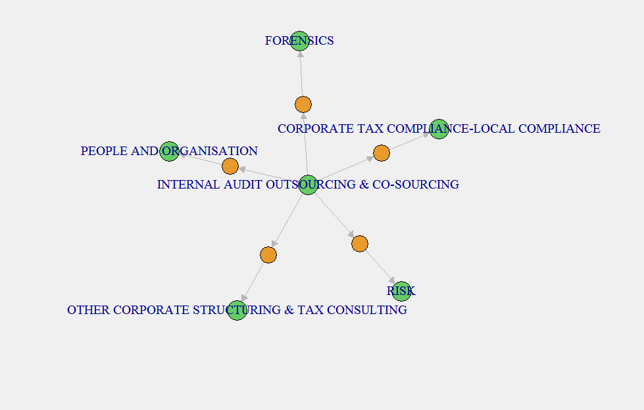

Slide 14
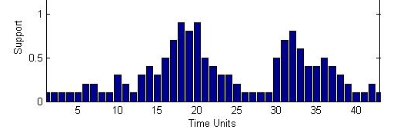
Apriori Limitations
The Apriori Algorithm finds the frequent itemsets in the transaction database which satisfy the minimum support threshold for the entire transaction database.
What about those itemsets which are highly frequent over a limited period of time and not over the entire set of transactions?
For e.g. – Seasonal Products like Tax products (During taxation months)
The itemsets extracted using the Apriori Algorithm, might not be valid for the entire period over which association rule mining has been performed.
Does not consider worth of itemsets, only concentrates on the associative property
Does not consider the order of transactions, only associations (A,B = B,A)
Pruning based on pruning functions that don’t consider the transaction Price

Slide 15
Other Algorithms for Associative Rule learning
AprioriDP (Differentially Private Frequent Itemset)
Eclat
Frequent Pattern -growth
Enhancements and Alternatives to Associative Rule learning
Calendar-based Temporal Association Rule Mining
Time Series Clustering (K –Means)

Slide 17
Dataset wish list for a highly effective Retail Market Basket Analysis
• Date • Loyalty Card (if appropriate) • Individual UPCs/SKUs along with quantities and prices
The next most desirable attribute is typically some measure of profit for each UPC/SKU in the basket.
• Exact time of transaction • Terminal/Lane •Cashier
• Duration of transaction • Time spent on actions in transaction • Net-price at item level accounting for coupons
• Item Weight • Returns •Tender details (cash, credit,vouchers etc)
• Reward points • Was UPC manually entered? • Was weight manually entered or from scale?
Supplement with additional sources of data such as:
• Demographic characteristics of consumer • Geo-demographics surrounding stores • Promotional details • Historical weather observations

Slide 18
http://www.learninglover.com/examples.php?id=28

